Slide 1
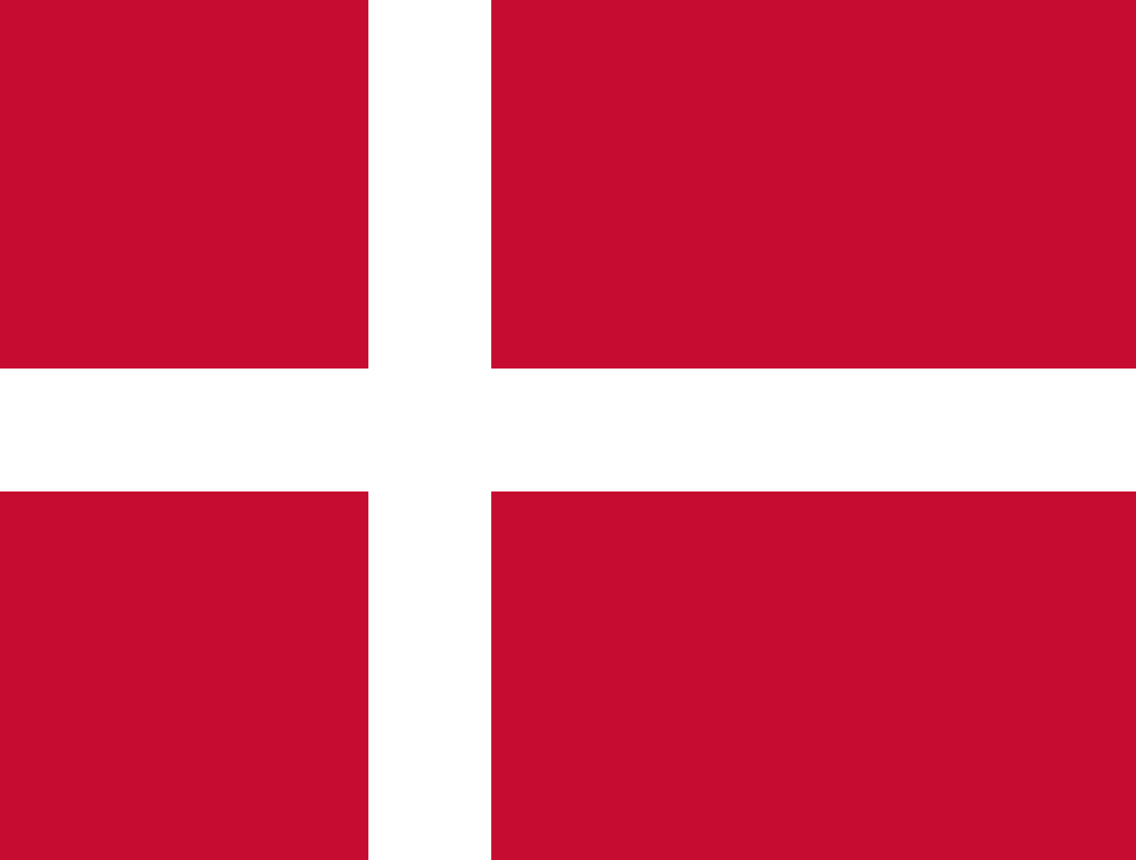
Denmark
Hana Grichová
Nela Plevová

Slide 2
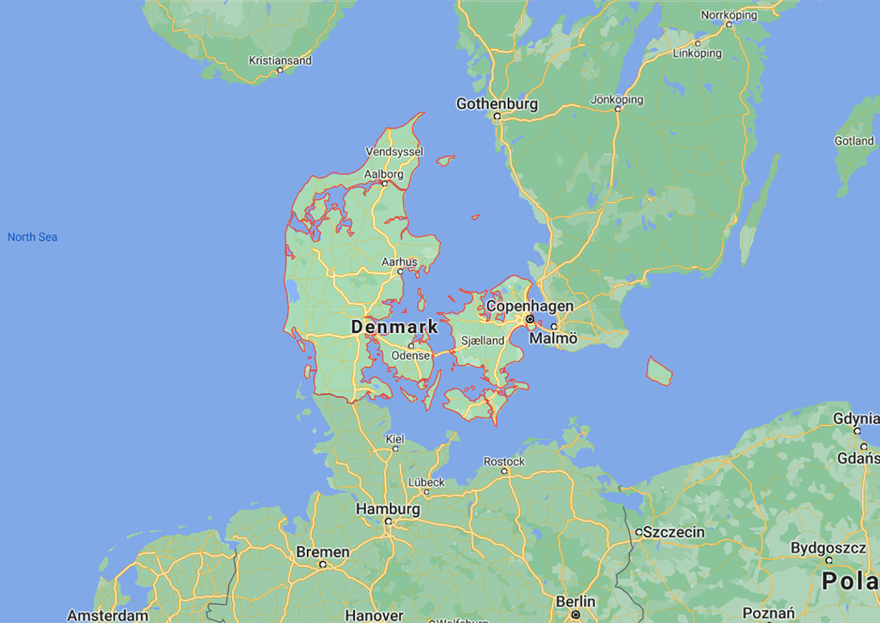
Denmark has an area of 42,943 and the biggest city Copenhagen is also the capital. Copenhagen is situated on the biggest island Zealand
It is a country in northern Europe. It is made up of the Jutland Peninsula and more than 400 islands in the North Sea.
Denmark has a long coastline with many lagoons, gulfs, and inlets. No part of Denmark is more than 67 kilometers from the sea.
It shares a border with Germany to the south. The country is almost two times the size of Massachusetts.

Slide 3
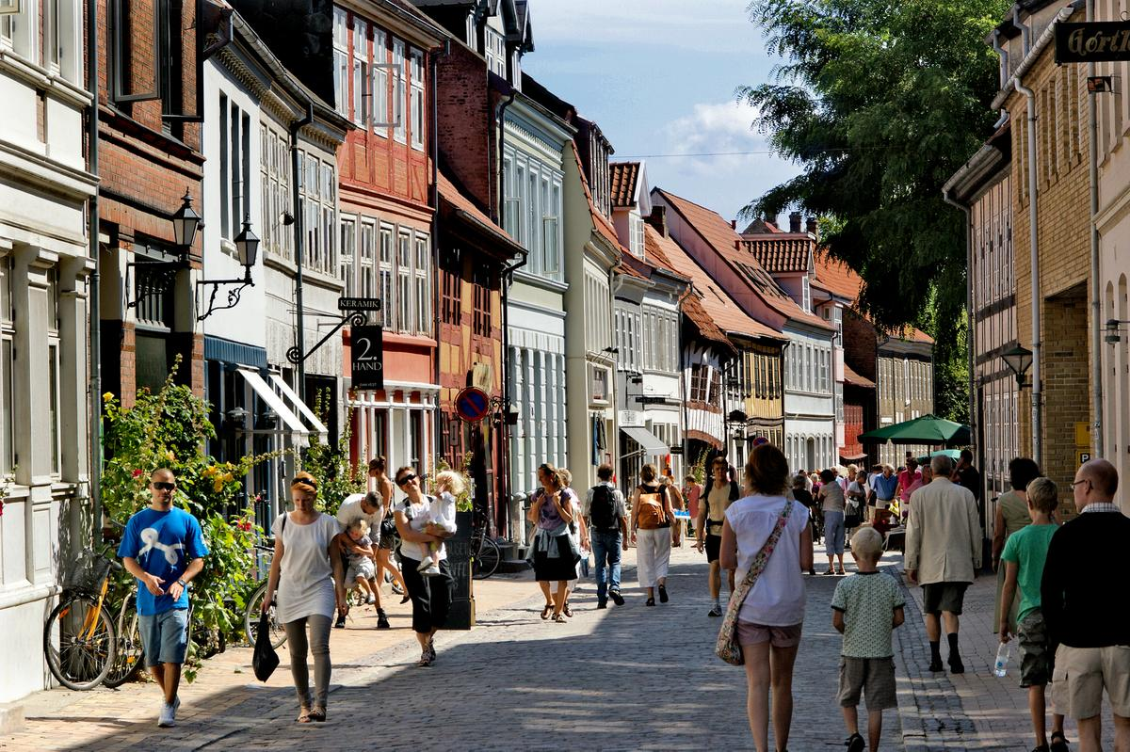
The capital of the country, Copenhagen is one of the most livable cities in the world.
Odense is the birthplace of Hans Christian Andersen, who lit up the world with his literary creations.
Founded by the Vikings, Aarhus is the second-largest city in the country, fittingly named the European Capital of Culture in 2017, for the wealth of attractions that it has to show off.
With its recently restored waterfront at the heart of the city, Aalborg is attempting to rejuvenate and breathe fresh life into the industrial parts of the city that have long lain neglected.

Slide 4
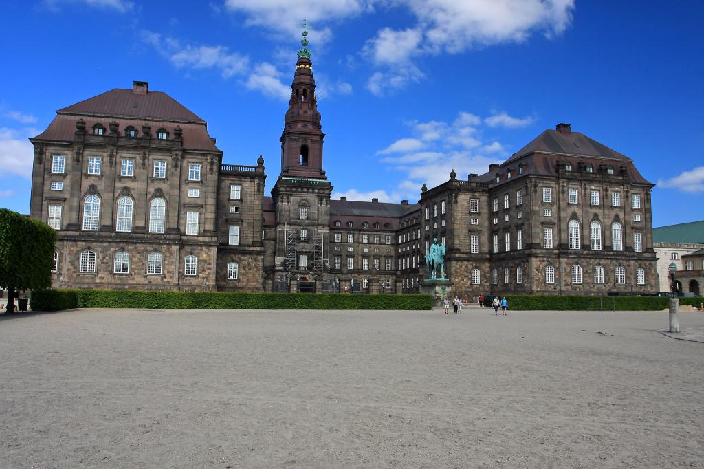
The Danish parliament is unicameral and called the Folketing It is the legislature of the Kingdom of Denmark, passing acts that apply in Denmark and, variably, Greenland and the Faroe Islands.
There are representatives of 16 parties in the Danish parliament, and since 1909 no party has had enough representatives to rule entirely on its own. Instead, multiple parties put together a ruling coalition.
The Folketing is also responsible for adopting the state´s budgets, approving the state's accounts, appointing and exercising control of the Government, and taking part in international co-operation.

Slide 5
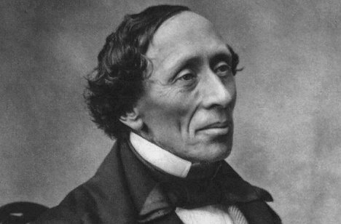
Legendary Danish children’s author Hans Christian Andersen is remembered for his fairy tales, such as The Little Mermaid, The Little Match Girl and The Emperor's New Clothes.
Five-time Danish Football Player of the Year Christian Eriksen has gained fame as a Tottenham Hotspur midfielder, and now plays for Inter Milan
Kevin Magnussen is a Formula 1 driver in an American team Haas

Slide 6
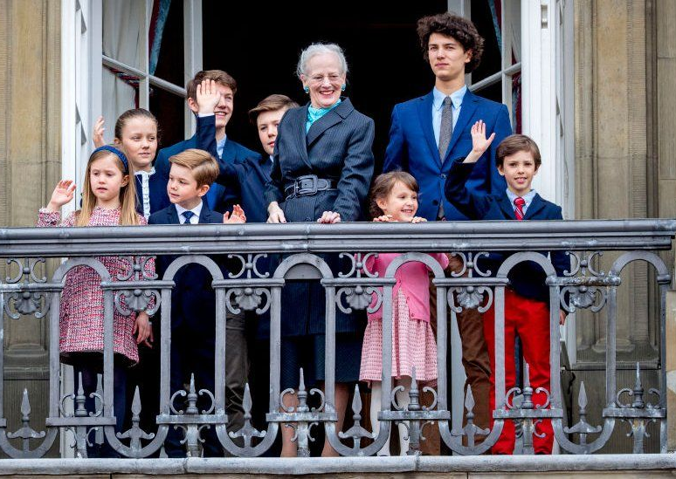
The current Kingdom of Denmark was founded by the Viking kings Gorm the Old and Harald Bluetooth in the 10th century. Originally an elective monarchy, it became hereditary only in the 17th century during the reign of Frederick III.
Queen Marghetre ascended the throne on the death of her father, King Frederick IX, on 14 January 1972. She became the first female monarch of Denmark since Margrethe I, ruler of the Scandinavian countries in 1375‒1412, during the Kalmar Union. Accordingly, her heir apparent is Crown Prince Frederik.

Slide 7
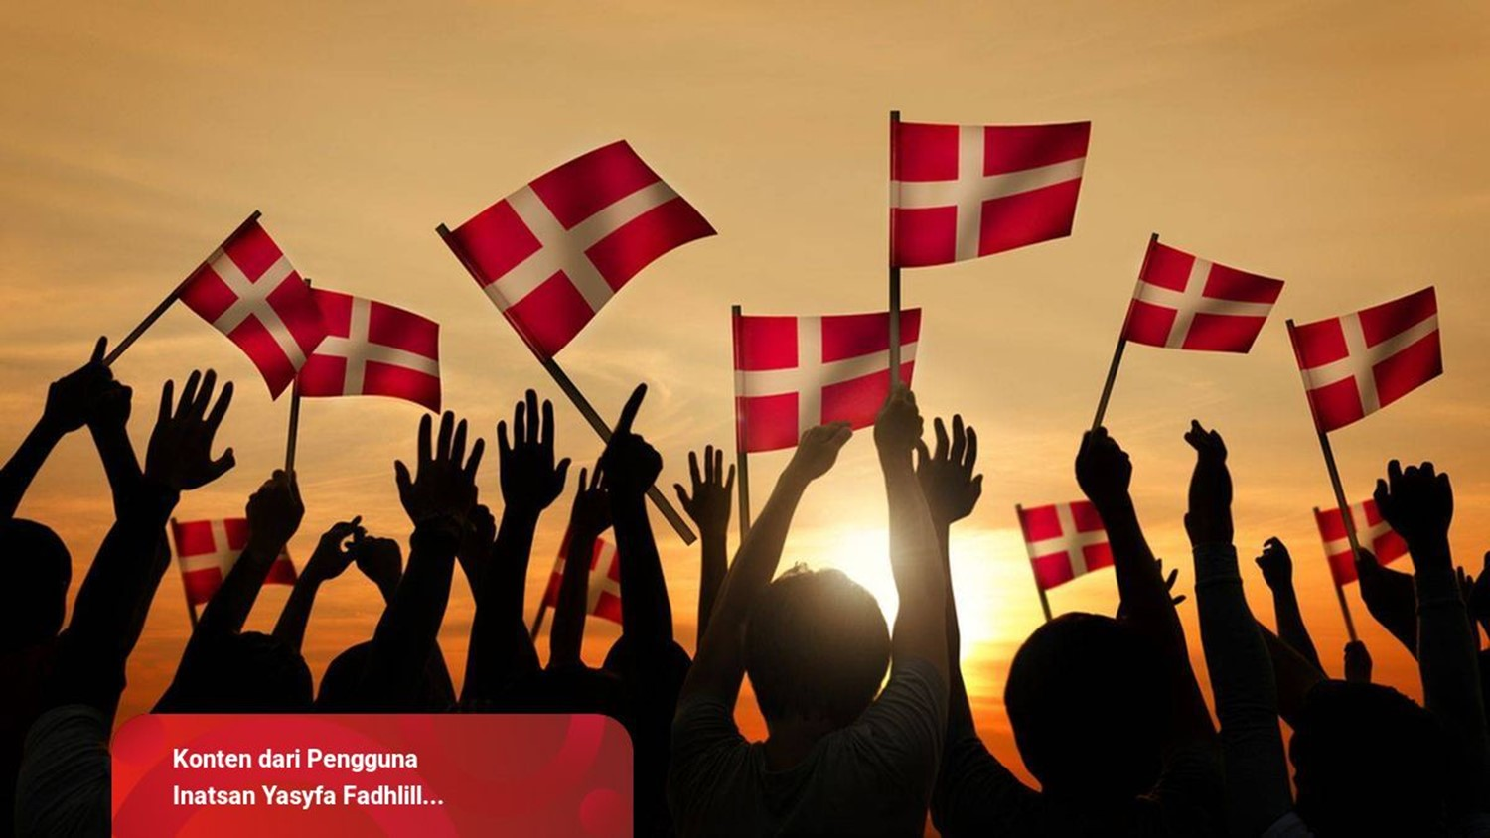
It has a population of 5.935 million, of which 800,000 live in the capital and largest city, Copenhagen.
The World Happiness Report frequently ranks Denmark's population as the happiest in the world. This has been credited to the country's highly considered education and health care systems.
86.11% of the population in Denmark is of Danish descent.
Christianity is the dominant religion in Denmark.

Slide 8
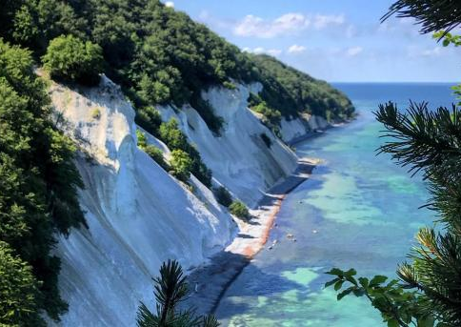
Denmark's geography is characterised by flat, arable land, sandy coasts, low elevation, and a temperate climate.
Denmark has a temperate climate marked by relatively cool summers and moderately cold winters.
Denmark's Lake District is a spectacular spread of nature. There is the river Gudenå, Denmark's only river, and all the interconnected lakes.
Denmark has approximately 900 streams with outlet to the sea.

Slide 9
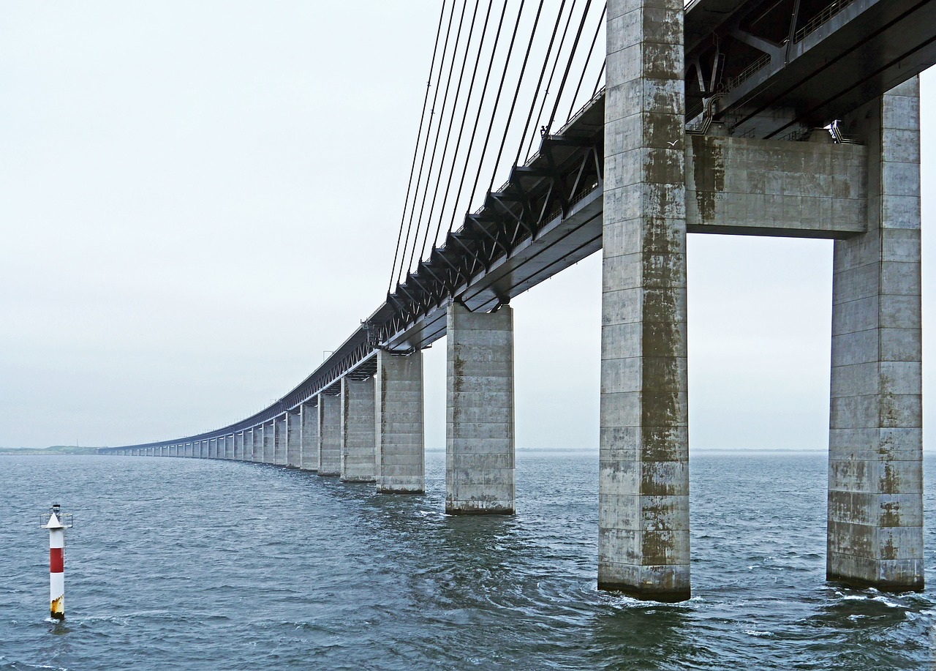
With 5,935 mil. inhabitants Denmark has the 36th largest national economy in the world
More than 60% of the total area of Denmark is used for agricultural purposes.
The diverse Danish energy sector plays an important role in the country's economy.
Tourism. Denmark's tourism industry contributes around 125 billion dollars in turnover to the country's economy.

