Slide 1
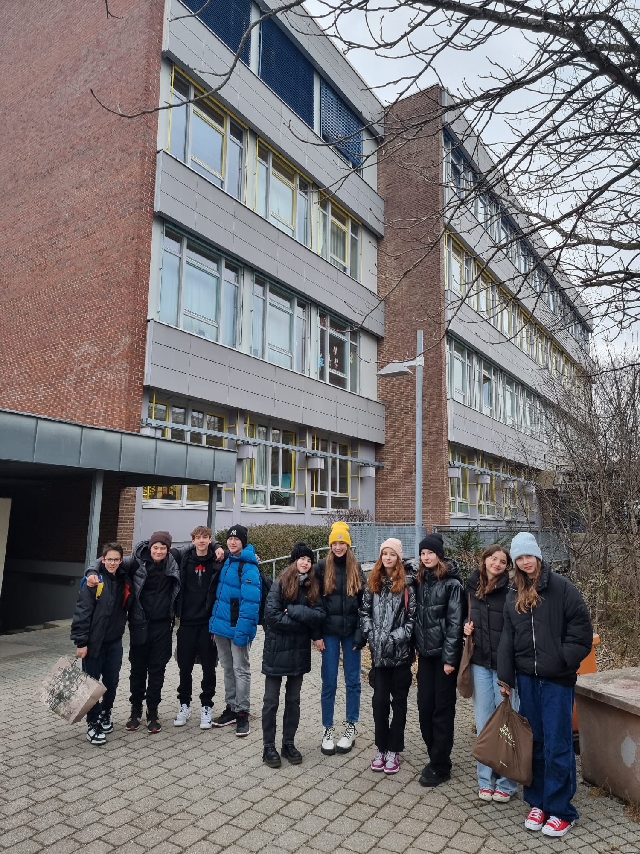
Mittelschule
Puchheim
-Alexander Bačkor
-Juraj Hradský
-Martin Diviš
-Marek Mičunek

Slide 2
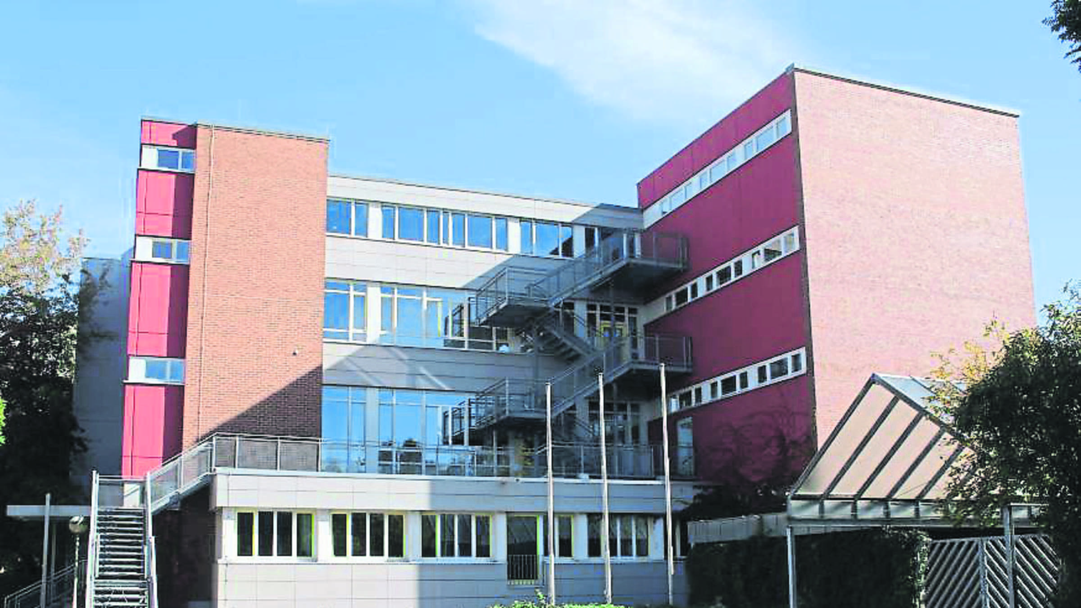
General knowledge
The school is located ln Lagerstrasse 26 in Puchheime
The principals name is Jochen Fuchs.
The school system is from 5th to 10th grade

Slide 3
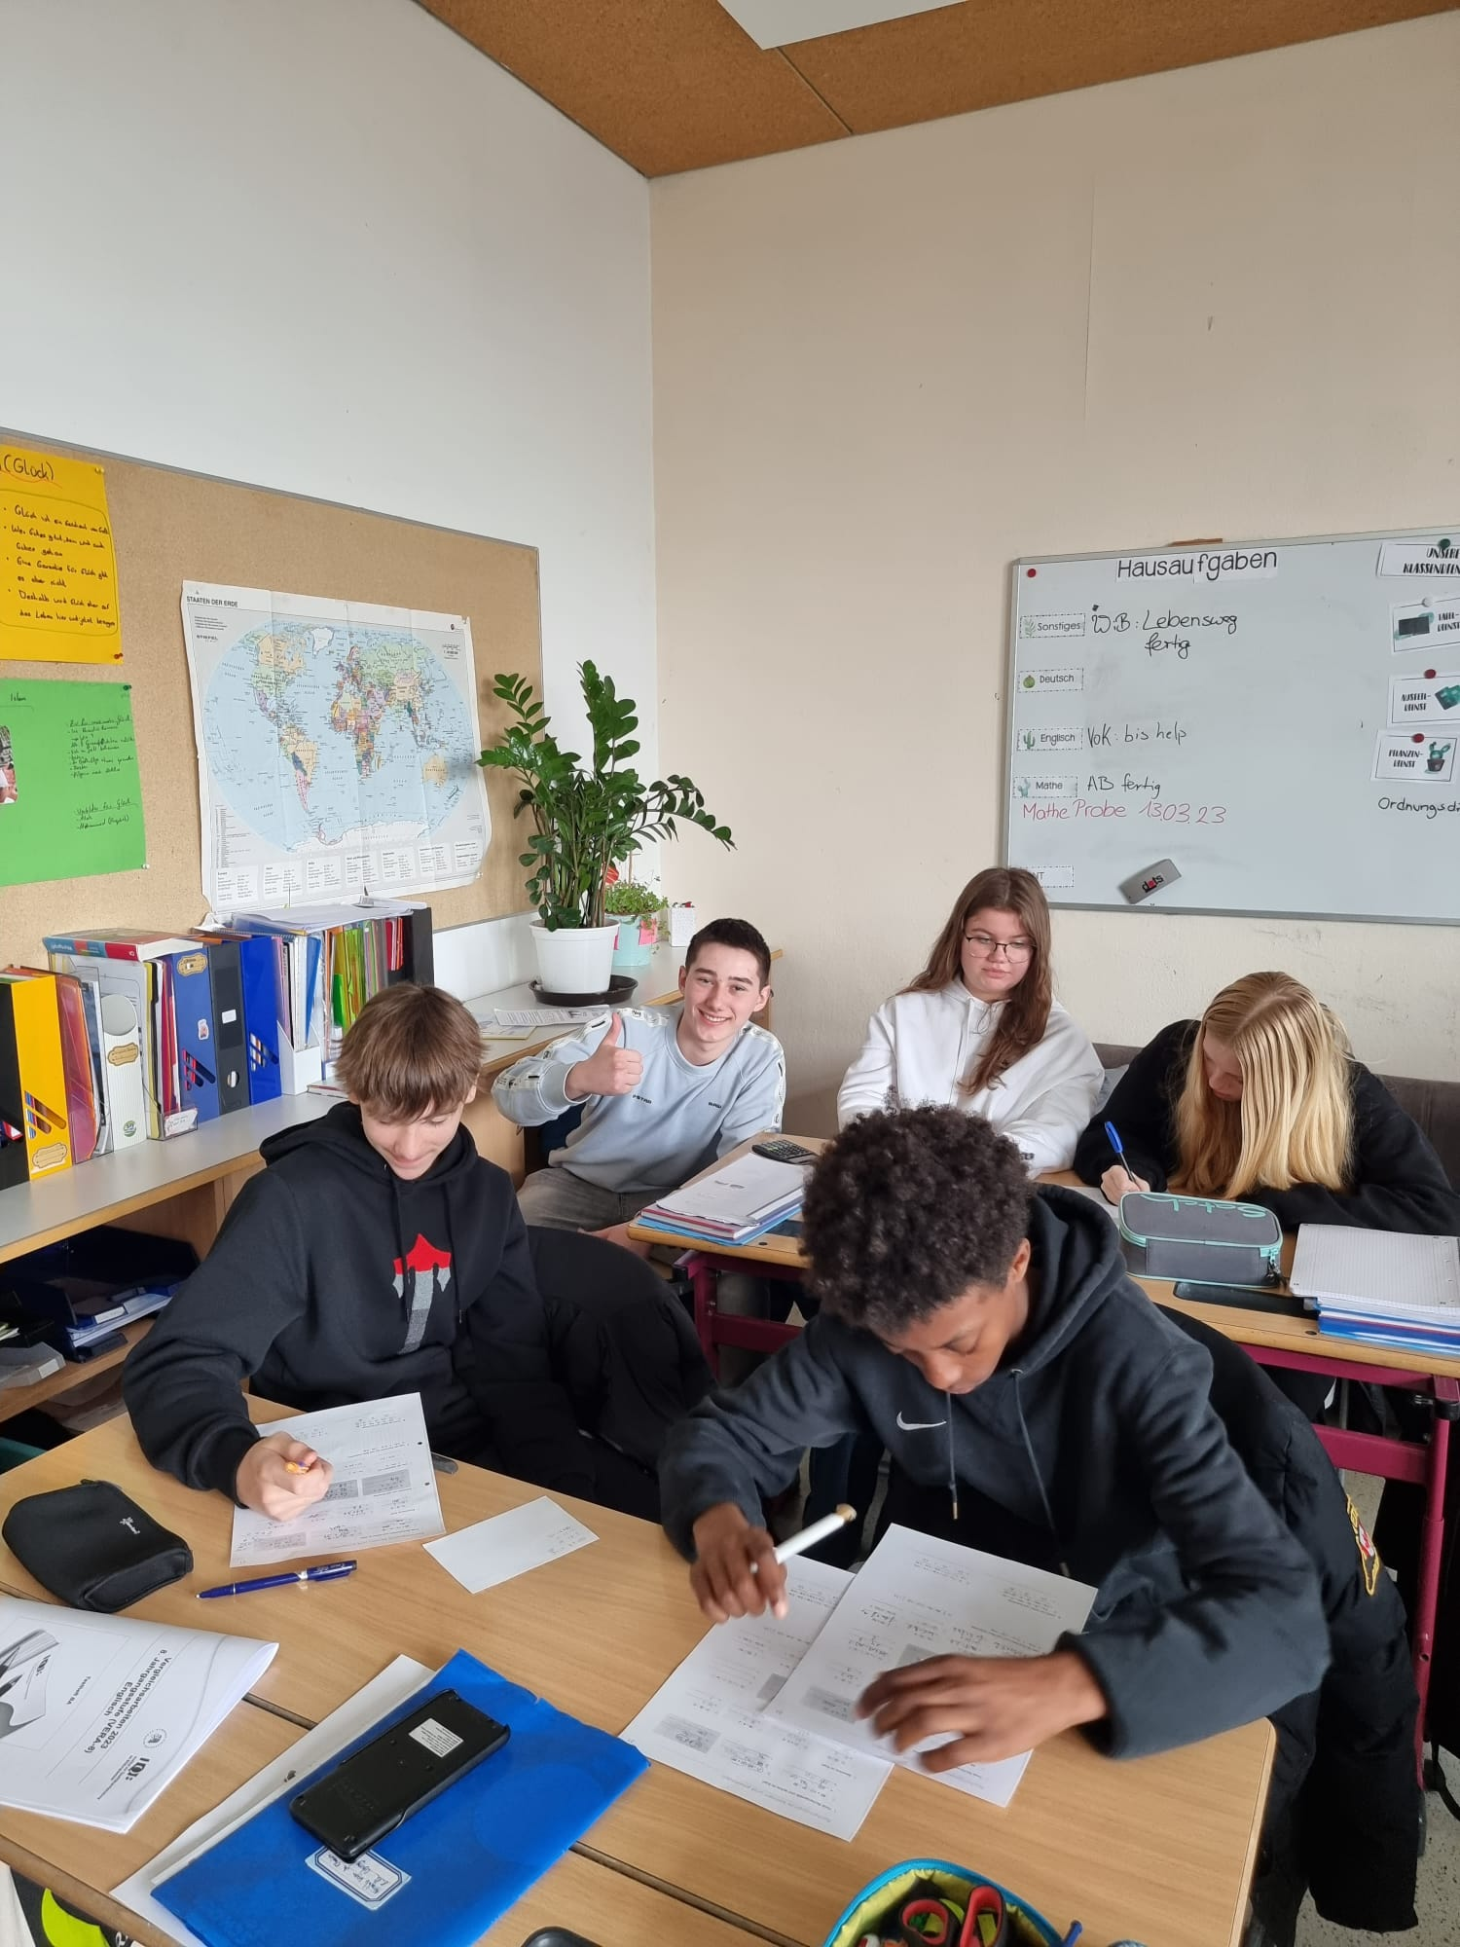
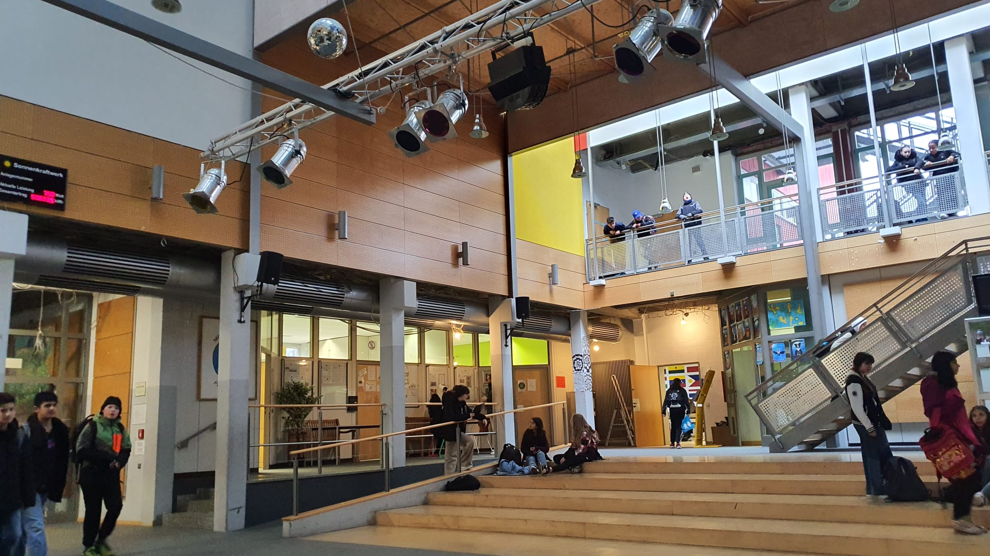
Mittelschule Puchheim from our perspective
One from many differences was that the school teached 10th grade
Since students get the chance to apply to better/private schools those who don‘t get to a public school like mittelschule Puchheim
What nobody expect to find was a school dog. A brown furry friend named Zeus who greeted everyone in the main hall.

Slide 4
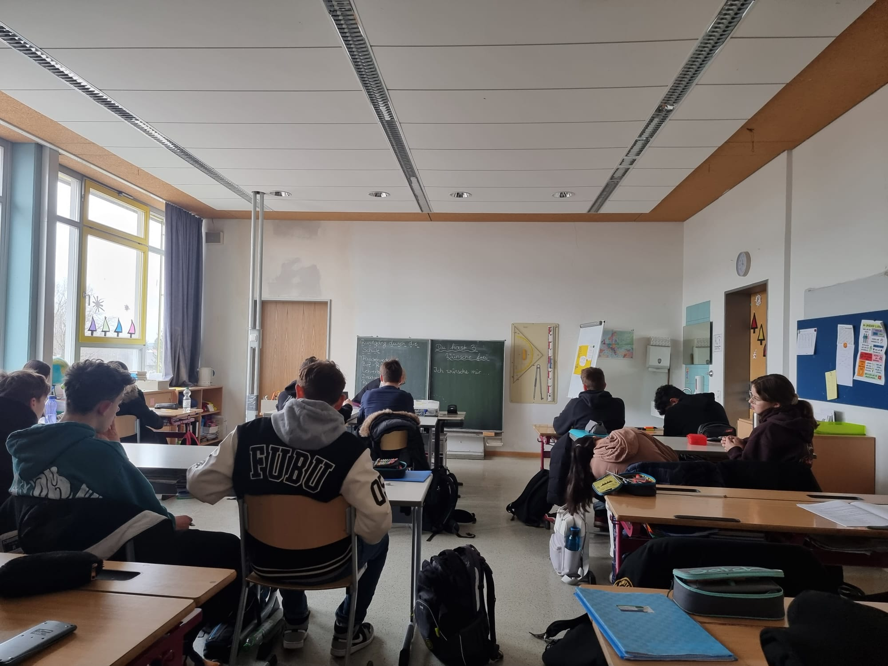
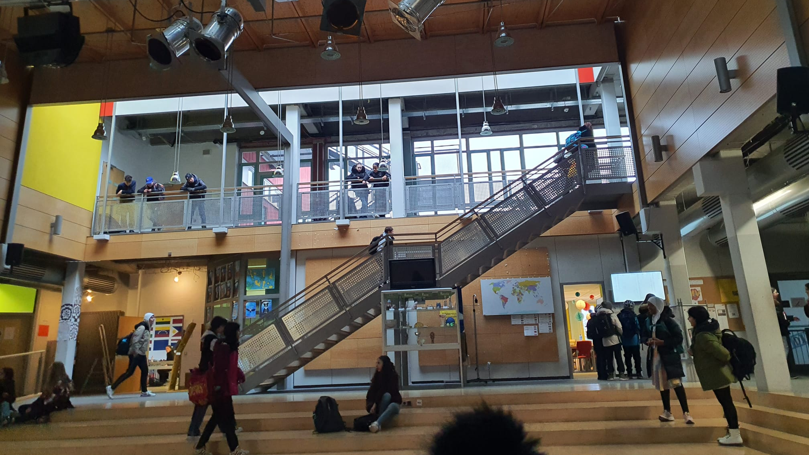
Our time and experience in Mittelshule Puchheim
The first thing we saw was a large auditorium.
We even noticed that they did‘t use lockers which we found strange
We were divided into 2 pairs (boys)
Marek Mičunek with Alexandrom Bačkorom in 10 Am
Martin Diviš and Juraj Hradský in 8 Mc
Classes were done by 1 p.m with a lot of classes done after the 3rd or 4th lesson
Students from 10 Am were 15 -18 years old yet they didn‘t speak english well as 8 Am which was rather supprising.

Slide 5
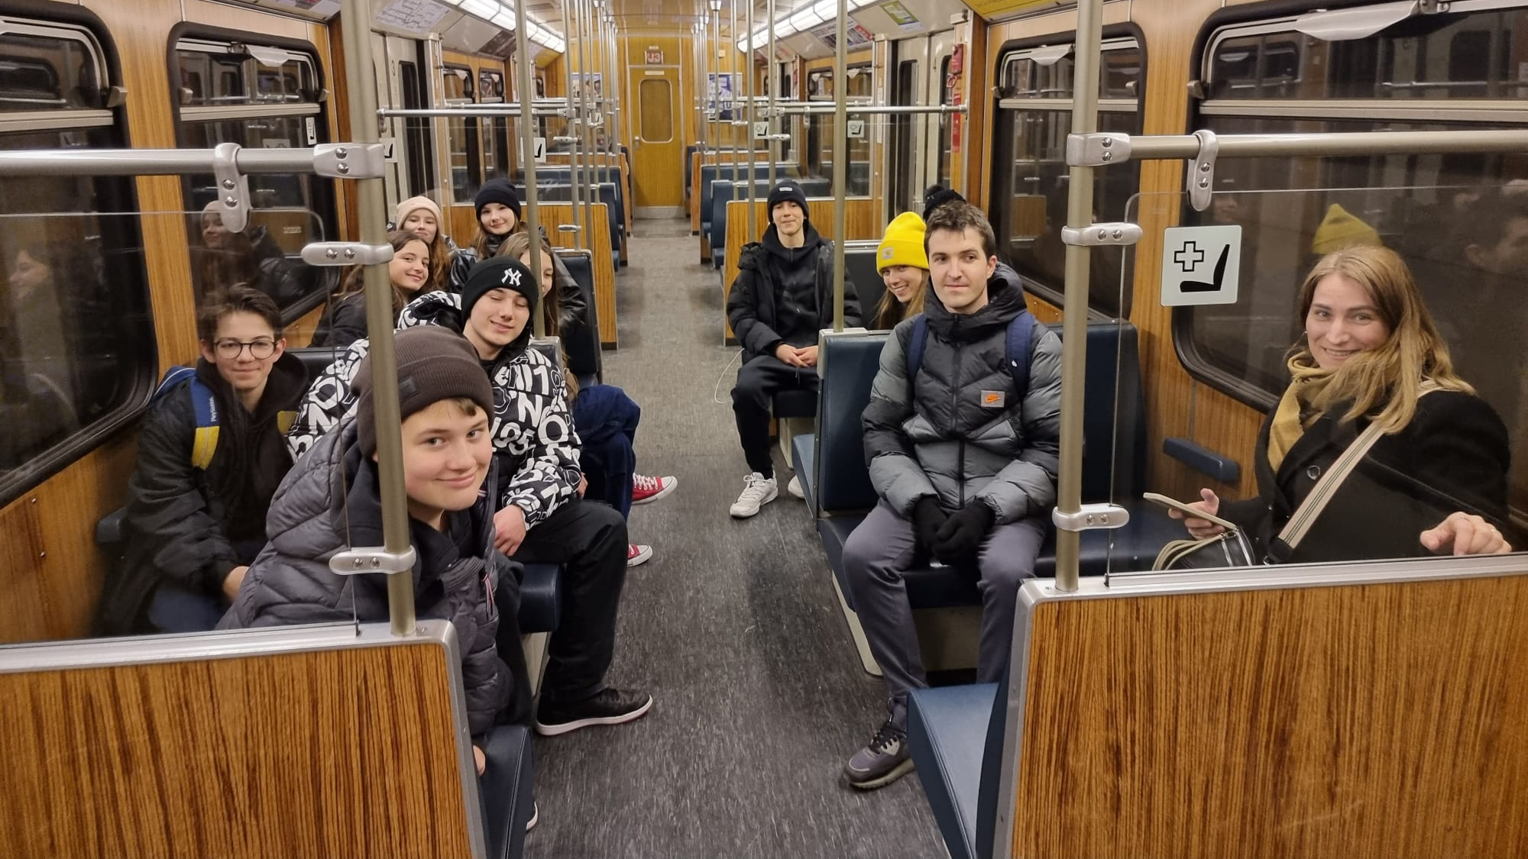
The way to school
We travelled by the metro about 40 minutes each day.
Our hotel was located in Munich close to the train station and a large metro station.

Slide 6
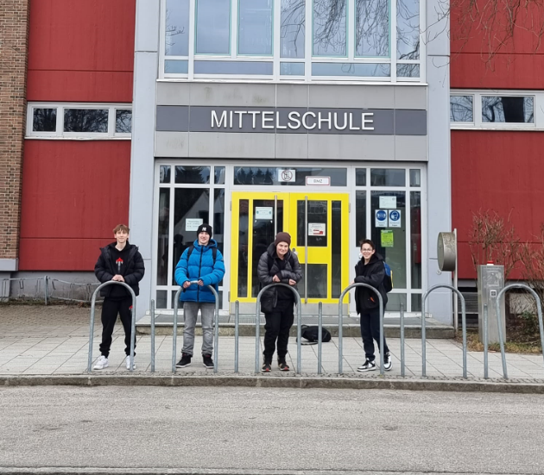
Overall feelings about the school
Our feelings and thougts about the school were very positive with a bit of weird and diffrent methods and traditions.
For example a school dog who rarely got out and got petted by the children, the fact that they didn‘t had to wear „indoor shoes“ or that they didn‘t have lockers.
There even was a common room for playing chess, doing homework or just spending the afternoon before heading home.

Slide 7
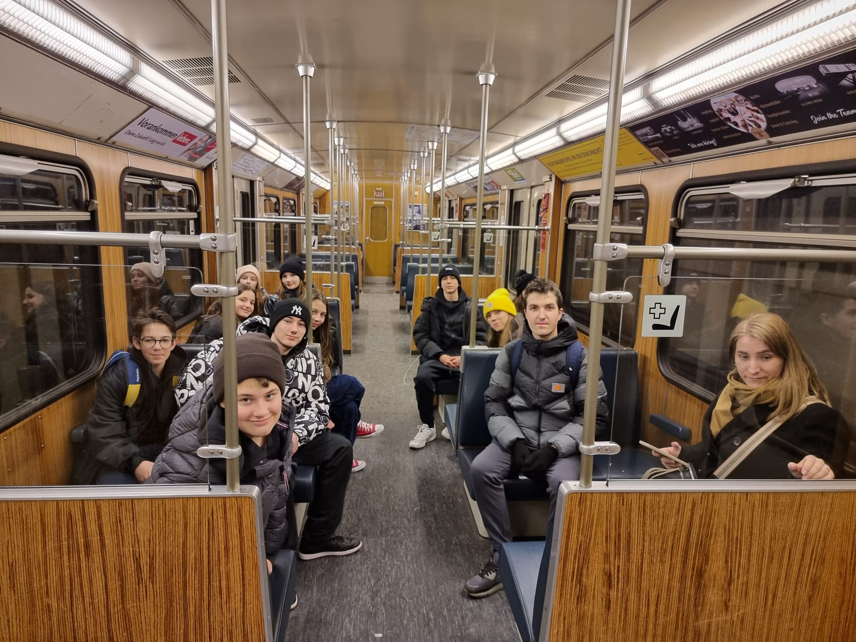
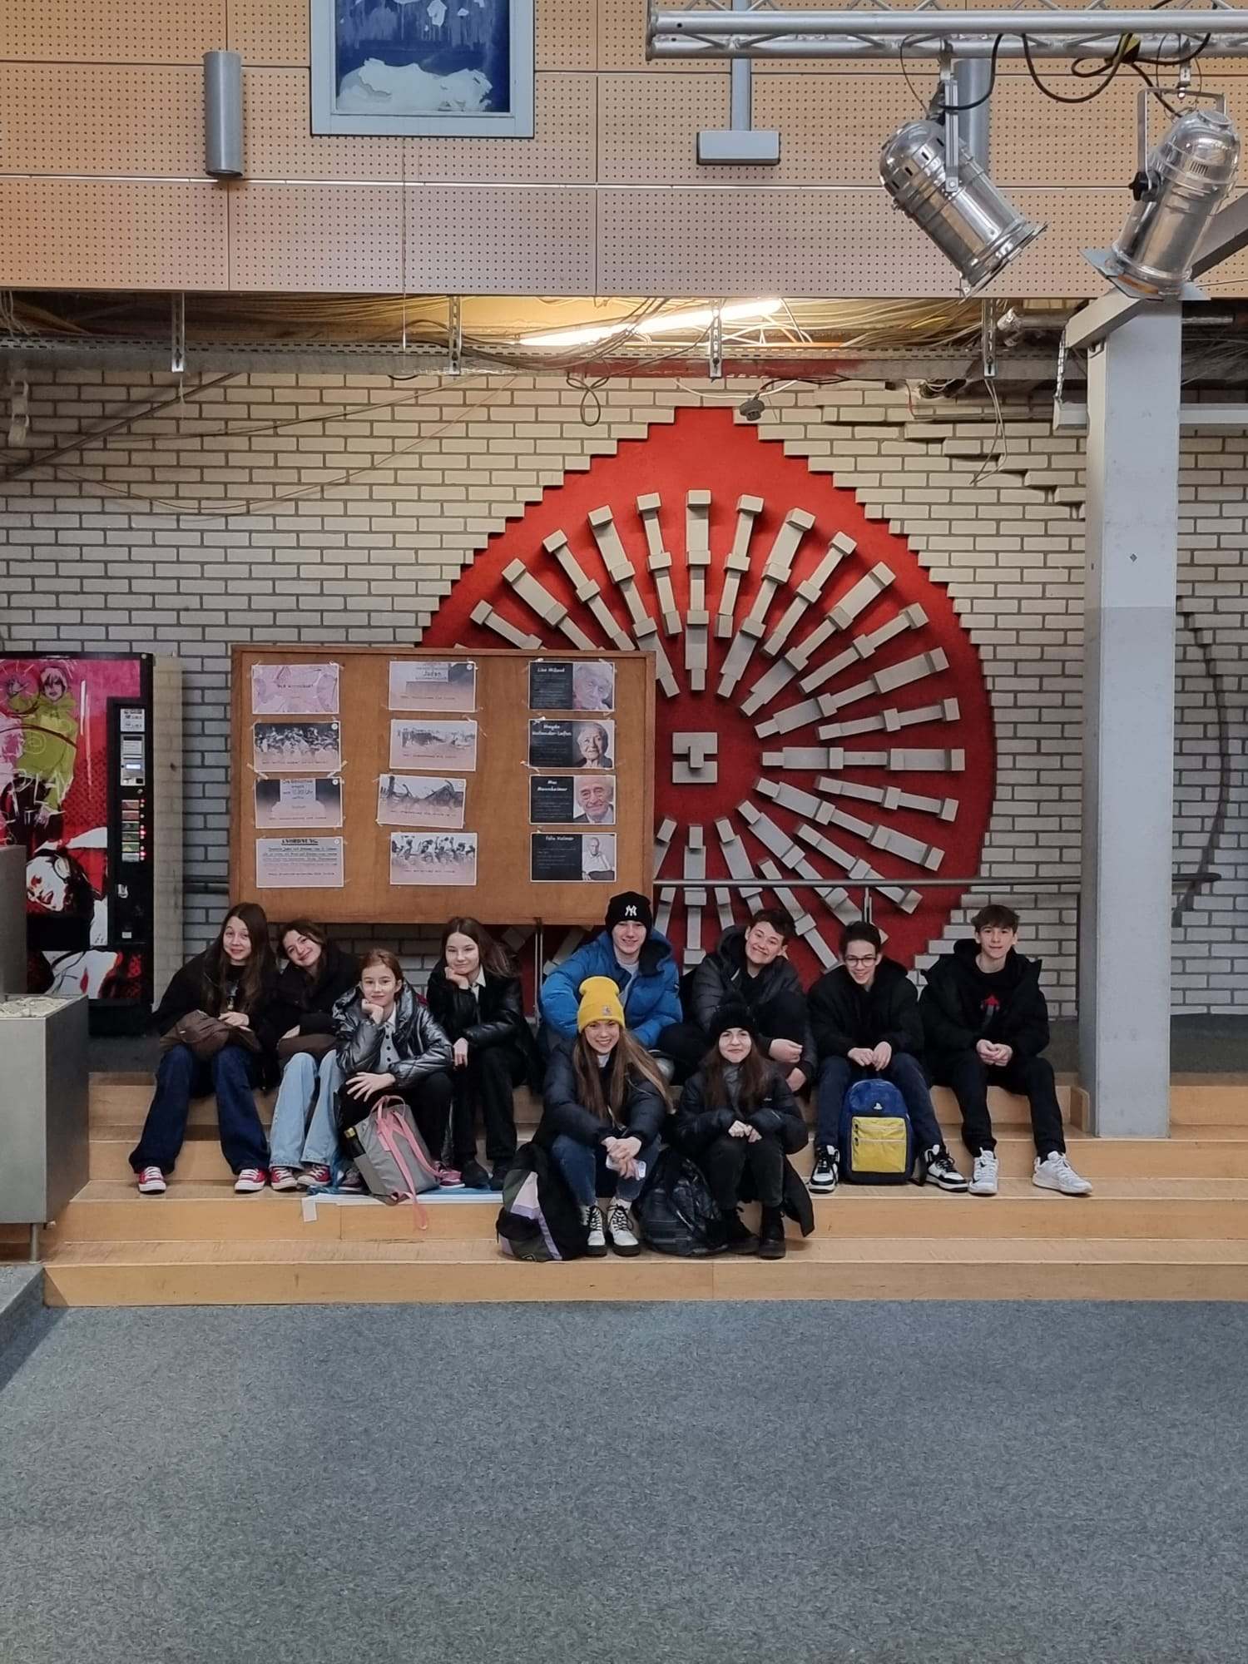
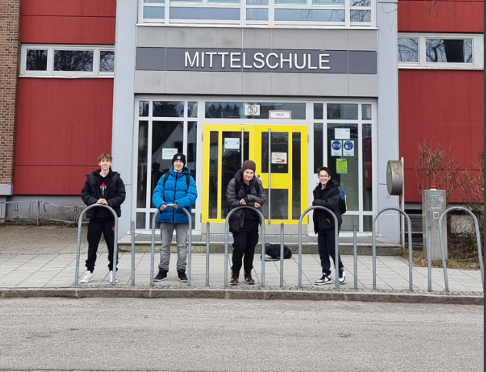
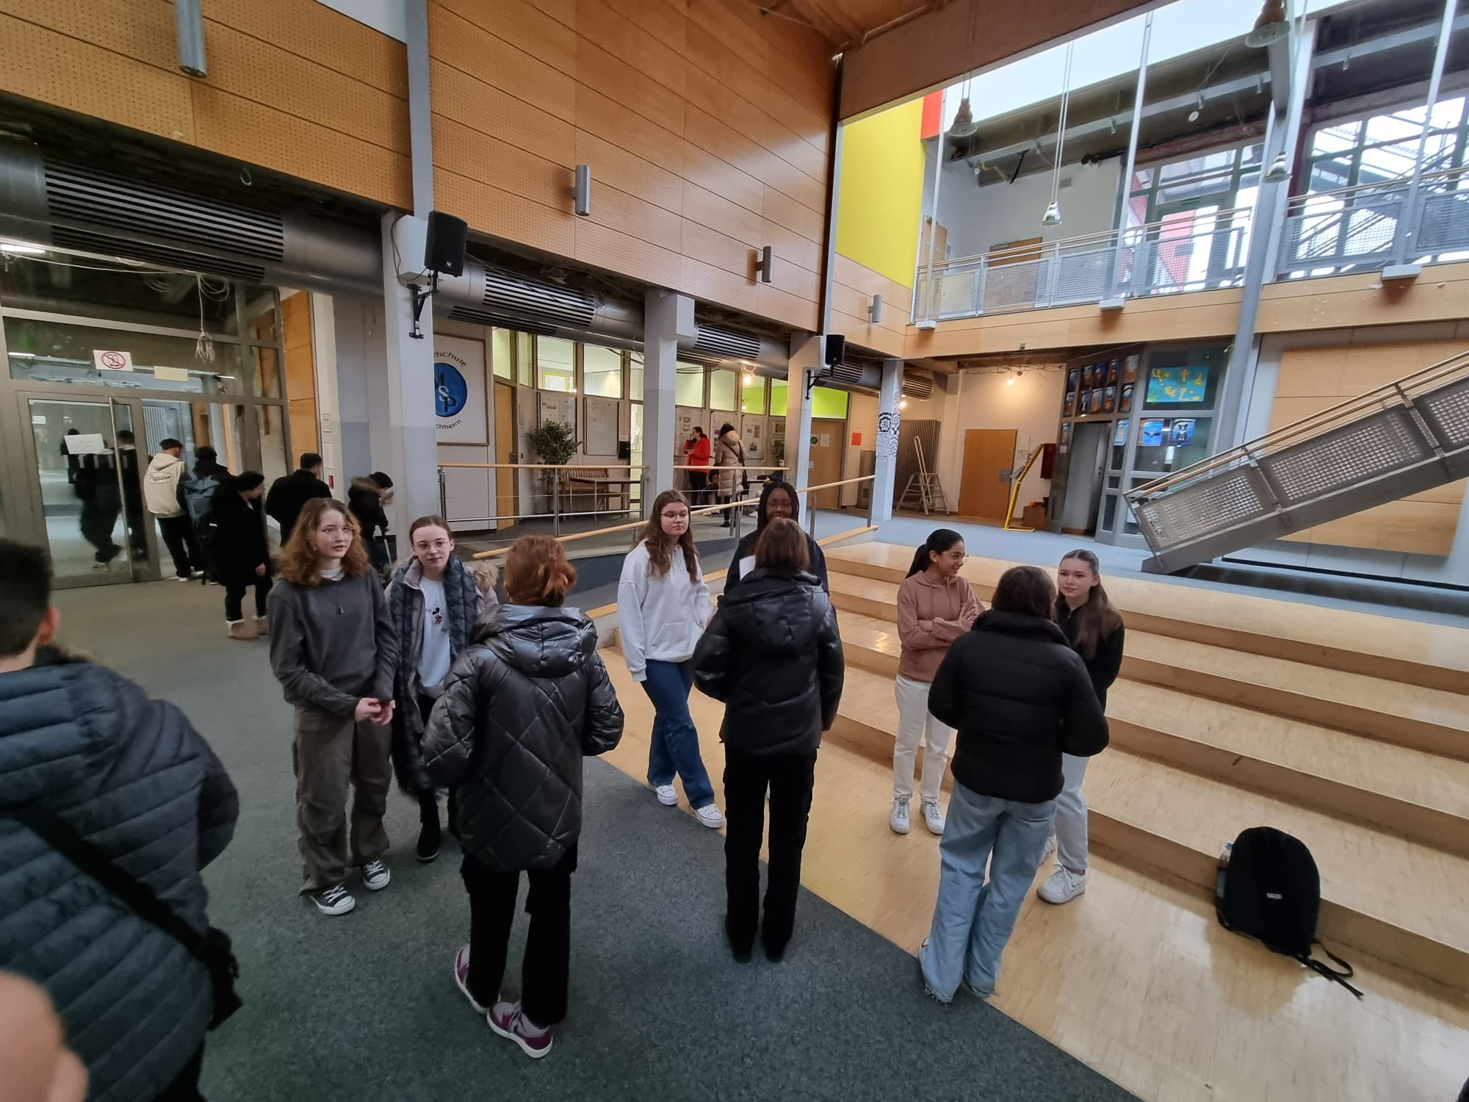
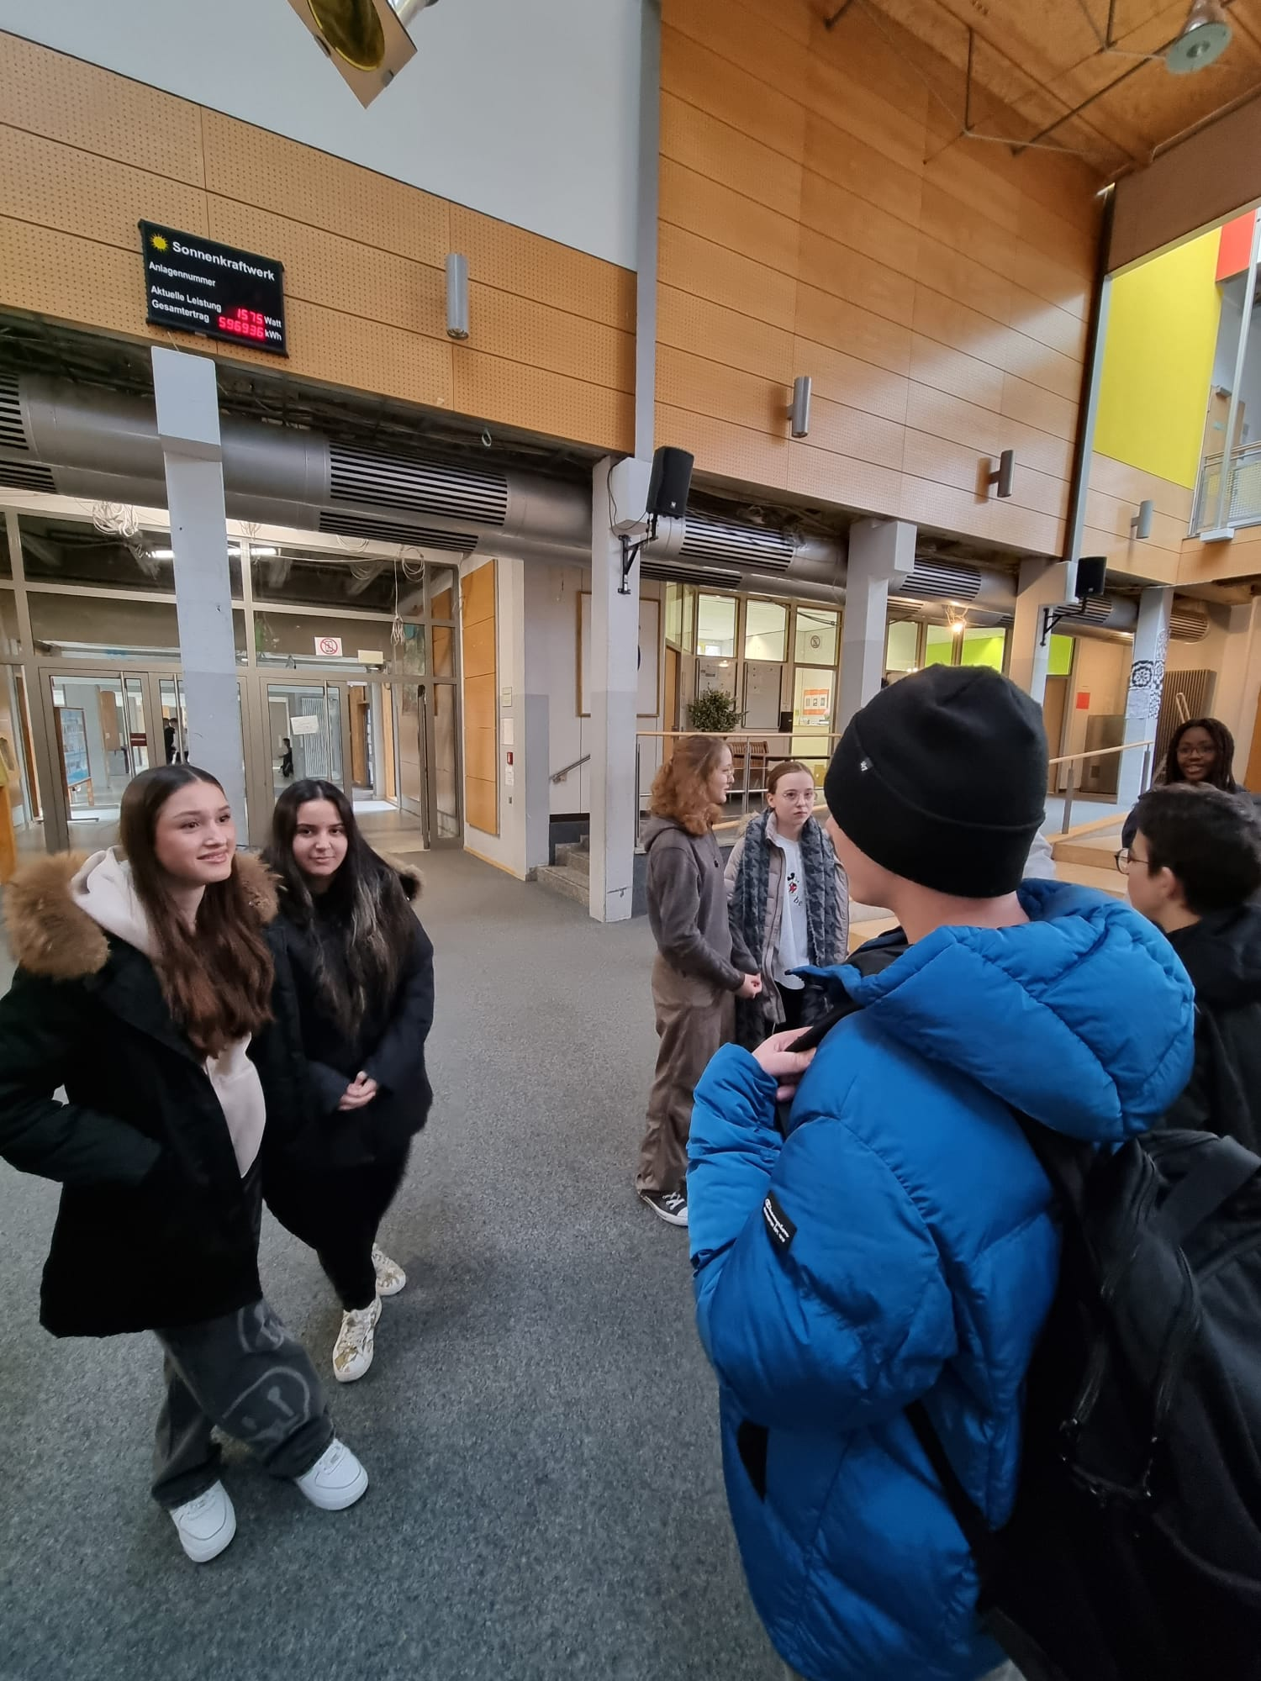
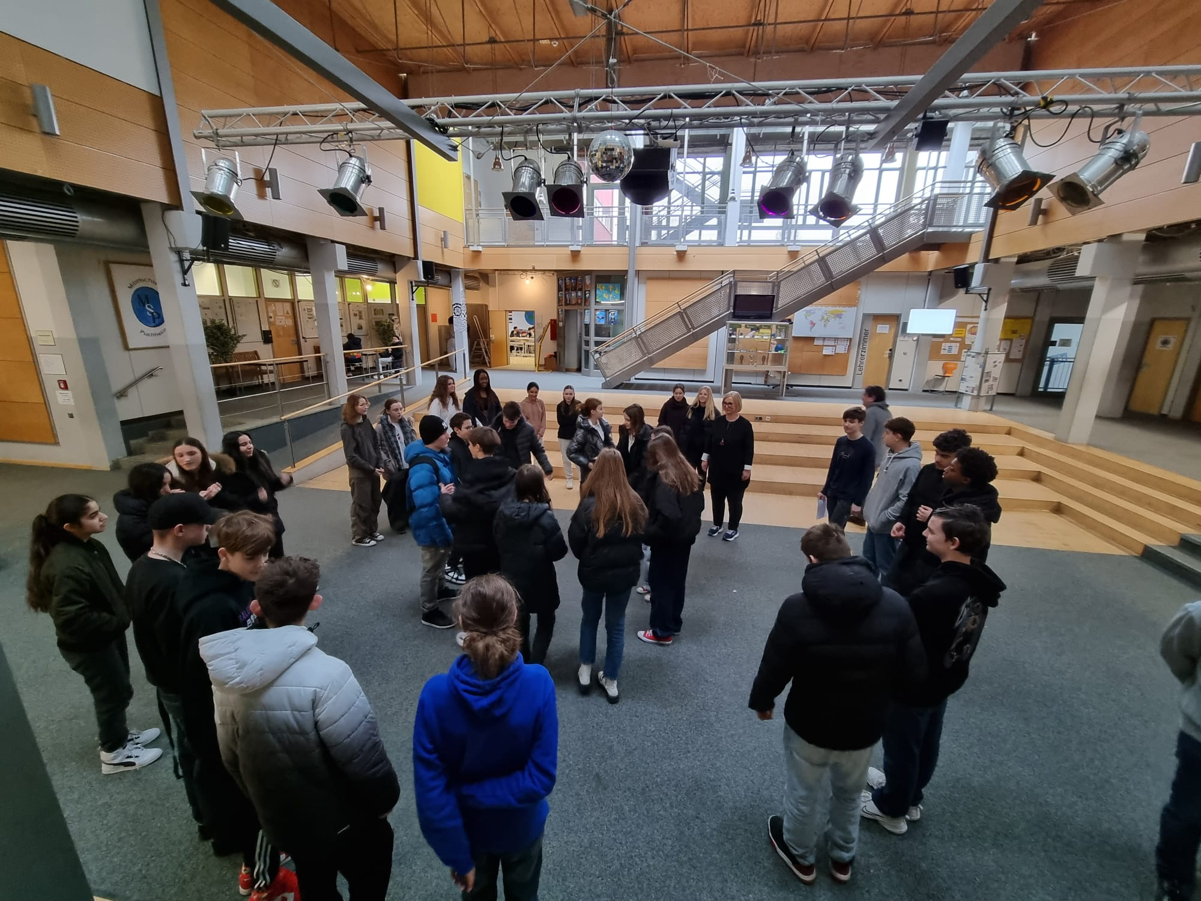
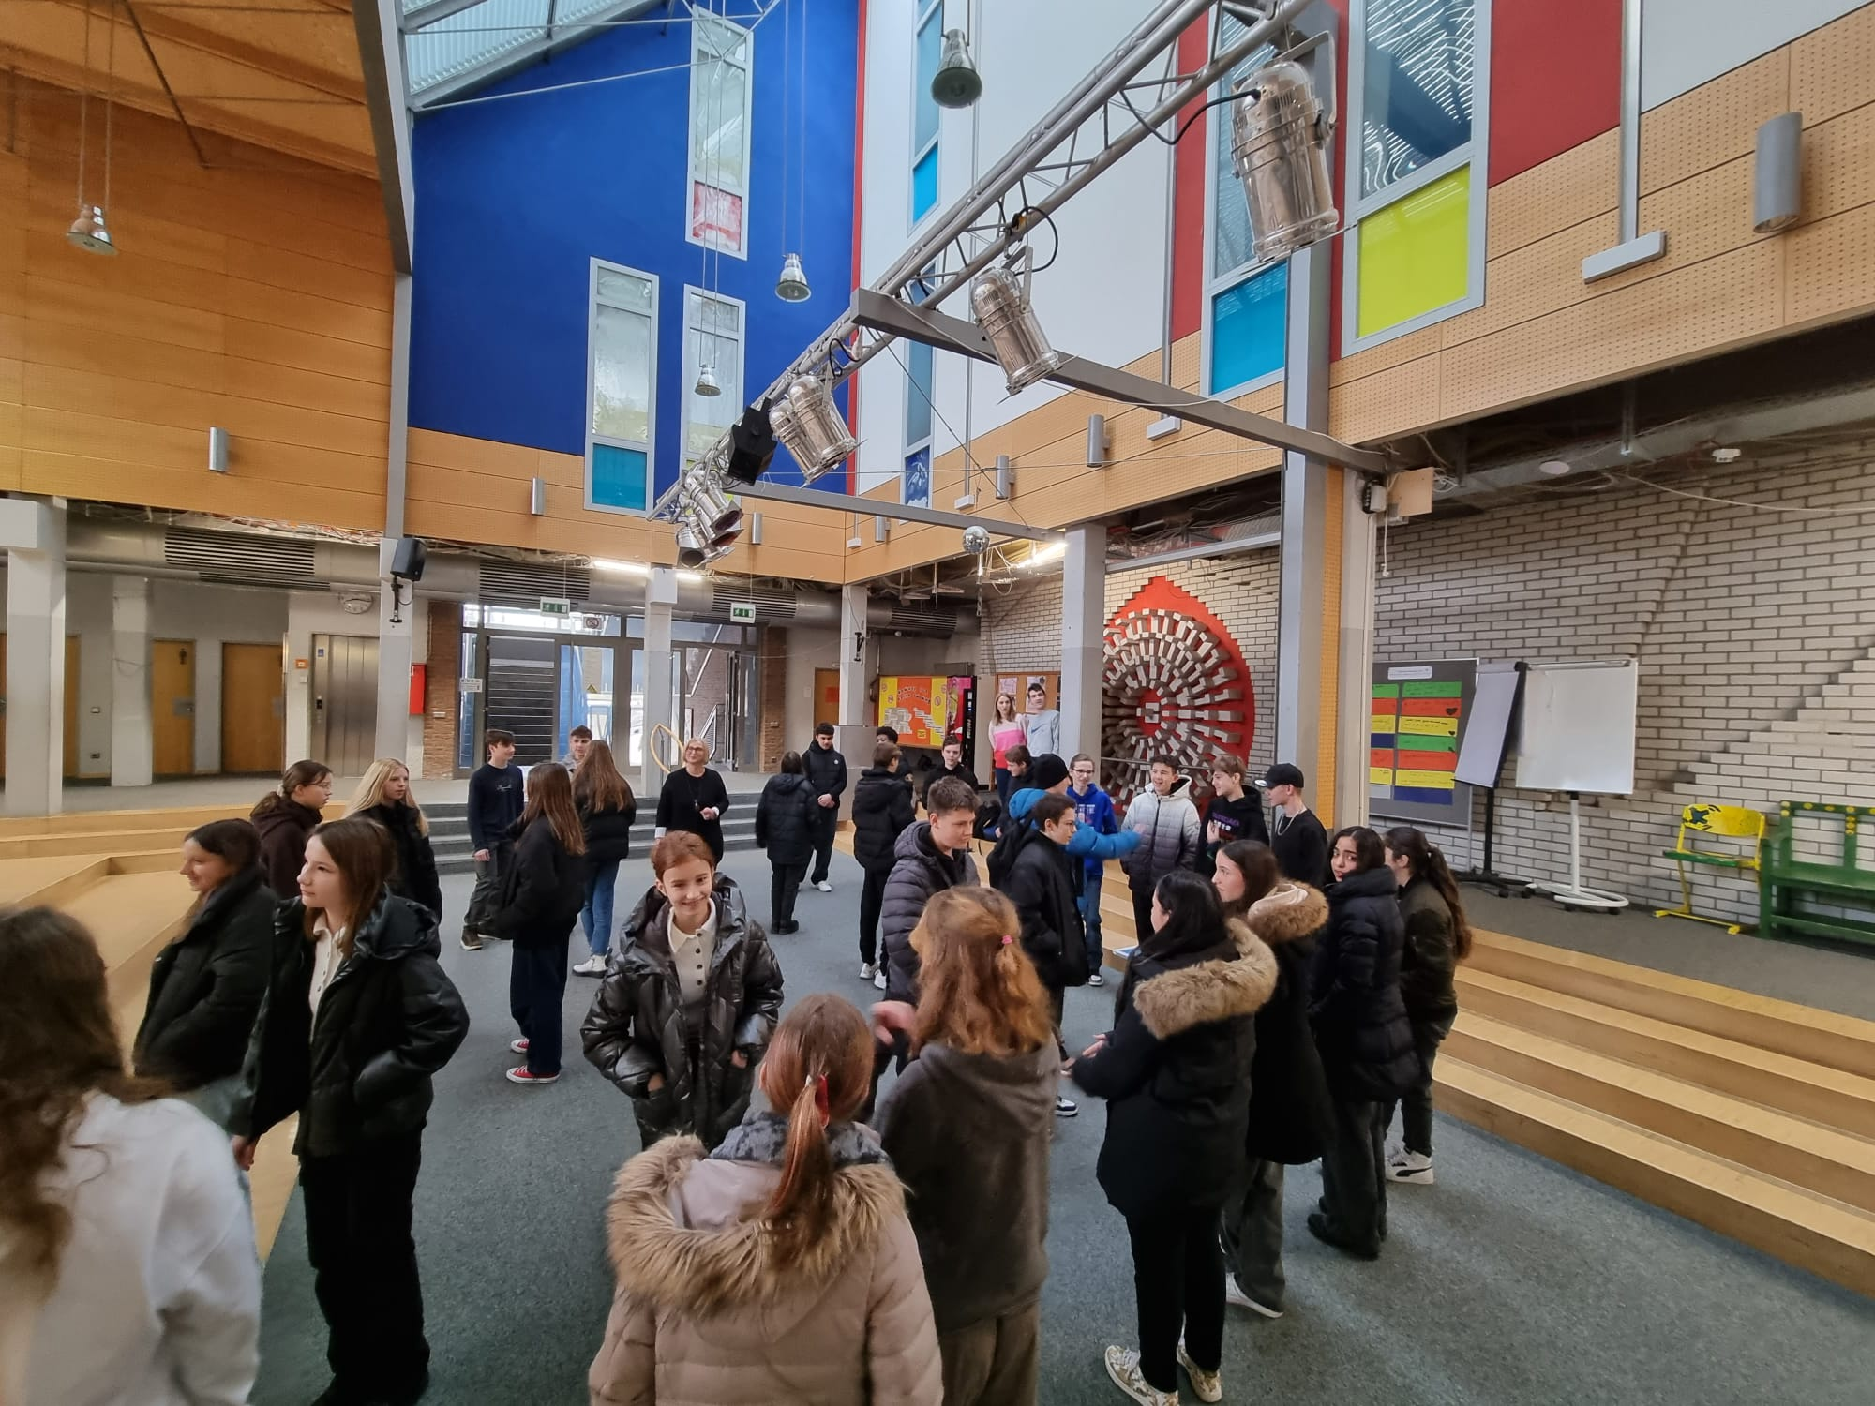
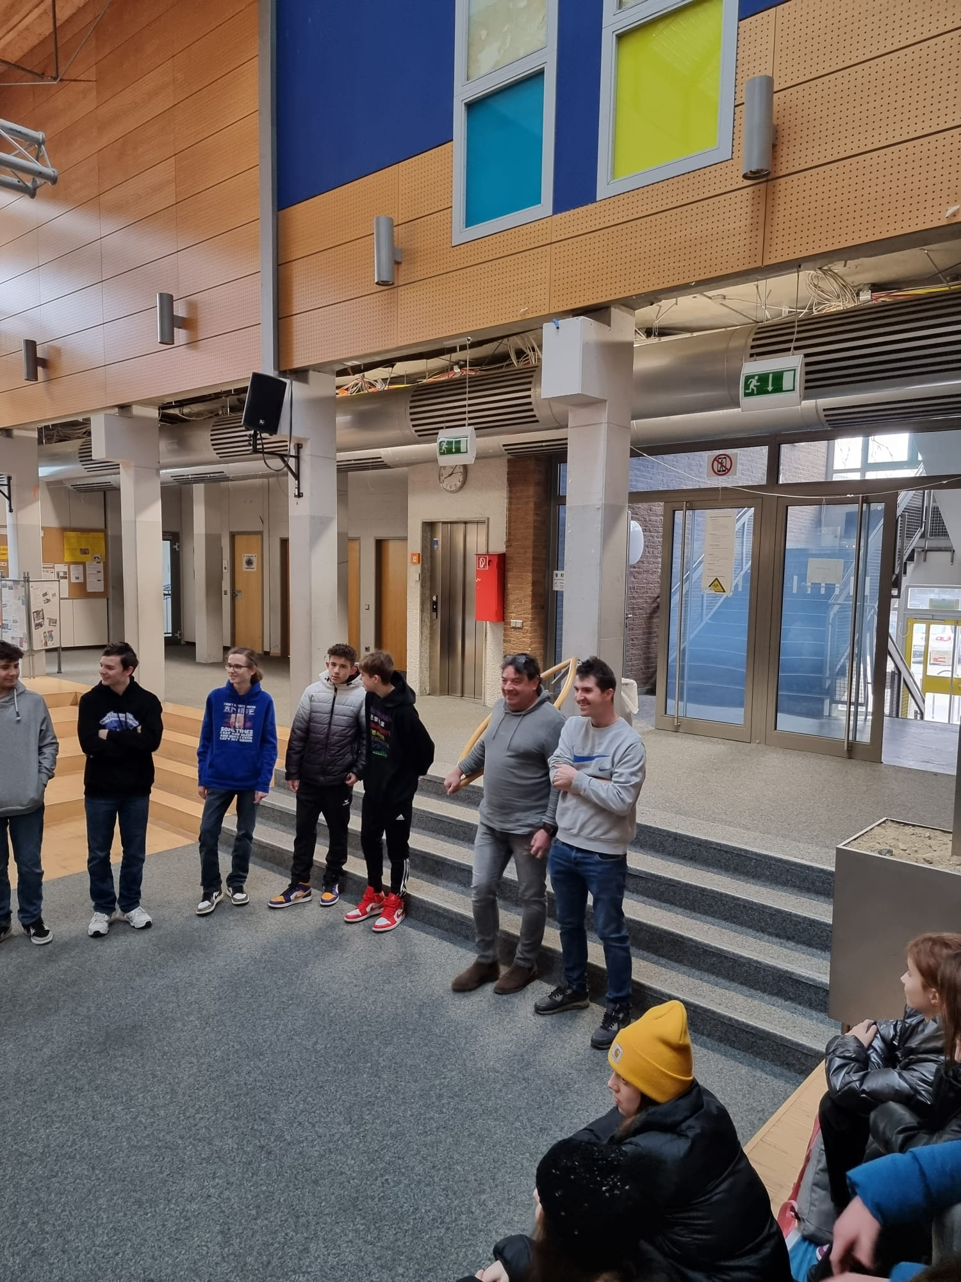
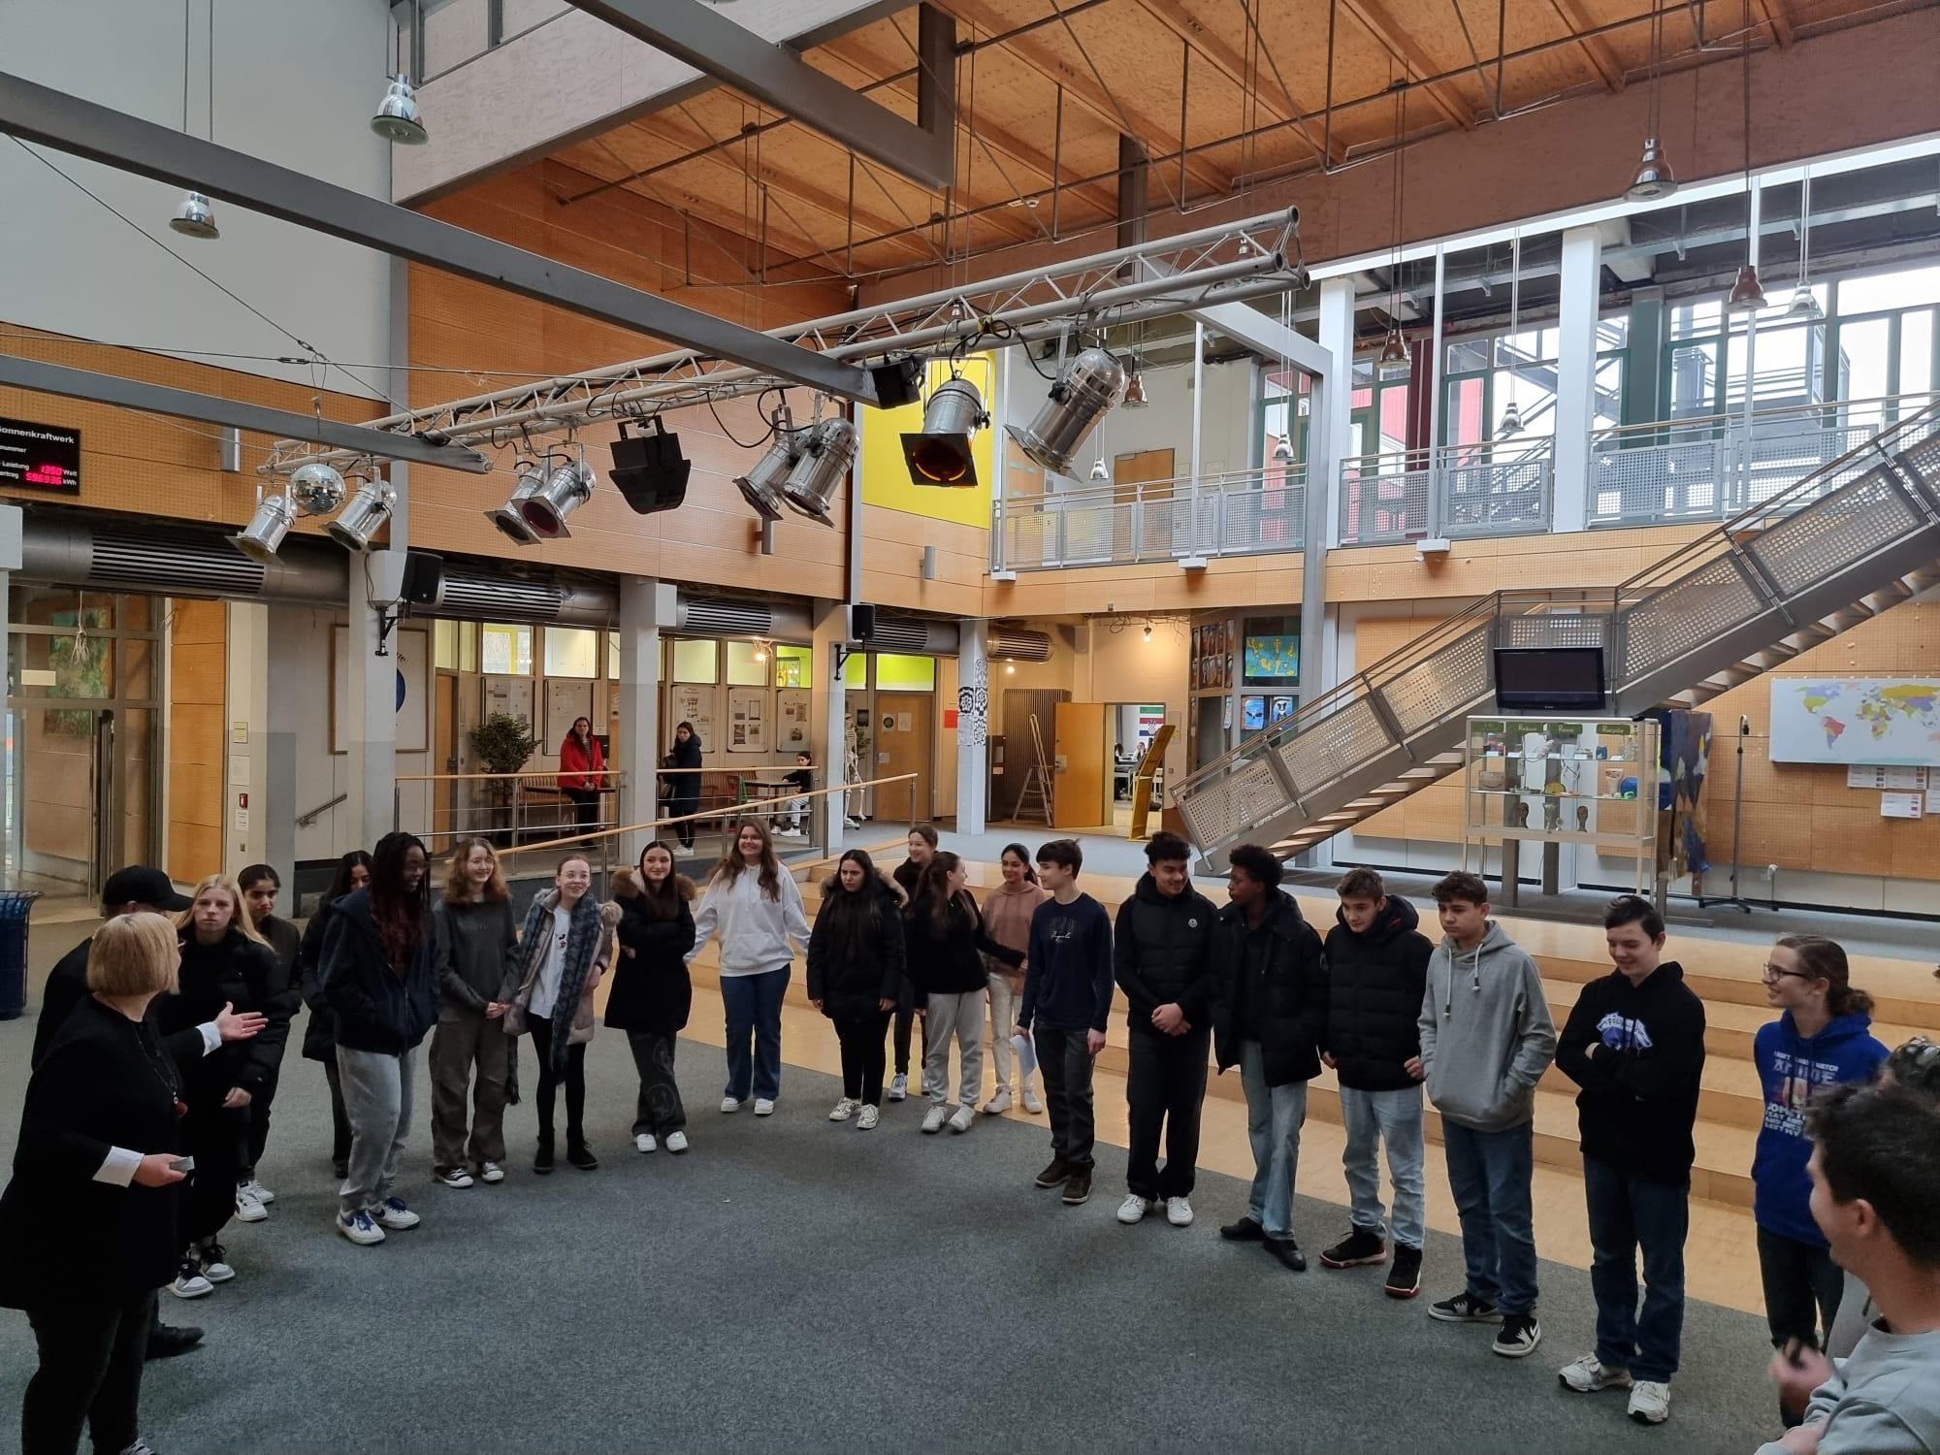
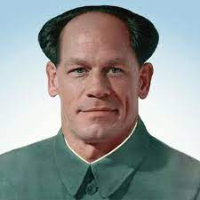
Thank you for your attention

