Slide 1
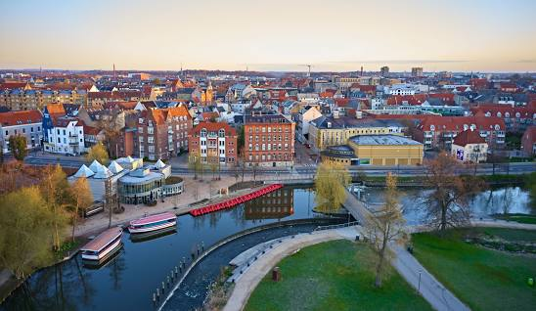
Modern history of Odense

Slide 2
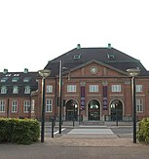
Some facts
Odense has a long history as a city. The city played a central role in the Middle Ages and Renaissance Denmark and became the birthplace of Denmark's world-famous author Hans Christian Andersen in 1805.
As Odense grew, it became a major destination for merchants. This was aided in the 1800s when a canal was built connecting Odense to the sea.
This saw the town expand outwards, remove the old gates and walls and really set itself up as an industrial power, second only to Copenhagen in terms of its influence in Scandinavia.

Slide 3
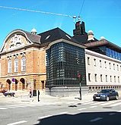
1800’s and early 20th century
From the 1840s, the city enjoyed a period of rapid expansion beyond its traditional boundaries, becoming Denmark's second largest city.
The city gates were demolished in 1851 and soon afterwards development extended to the area south of the river.
Glove production, which had begun in the 18th century, developed into one of the most important industries while the harbour facilities were further expanded.
The population of the city began to grow markedly; by 1900 it had 35,000 inhabitants.

Slide 4
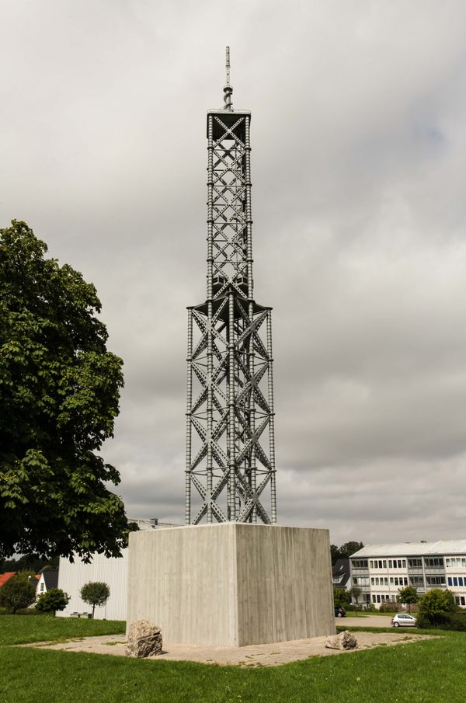
1940 - 2000
Odense's most famous landmark was Odinstårnet (The Odin Tower) constructed in 1935, as the second-tallest tower in Europe, only surpassed by the Eiffel Tower with its 177 meters.
Odinstårnet was blown up by a Danish Nazi group in 1944 and has never been rebuilt.
However, a miniature model now stands in Odinsparken in the area where the original was located.
Until the beginning of the Danish industrial revolution, Odense was also the second-largest city in modern Denmark, but has in recent times been overtaken by Aarhus.

Slide 5
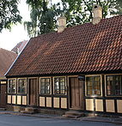
Interesting facts
In celebration of the thousandth anniversary in 1988, a forest named The Thousand Year Forest was planted, and in 2005 the city celebrated the 200th anniversary of the birth of Hans Christian Andersen.
The most used vehicle to travel across the city are bicycles
    Hans’s Christians house:

