Slide 1
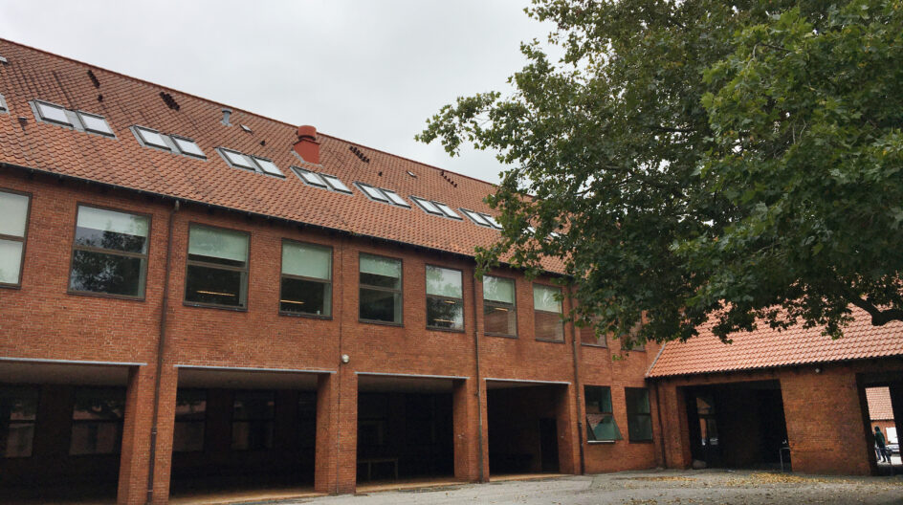
Risingskolen- the school of rising
Leona Kubíková 8.B
Tereza Orechovská 9.B

Slide 2
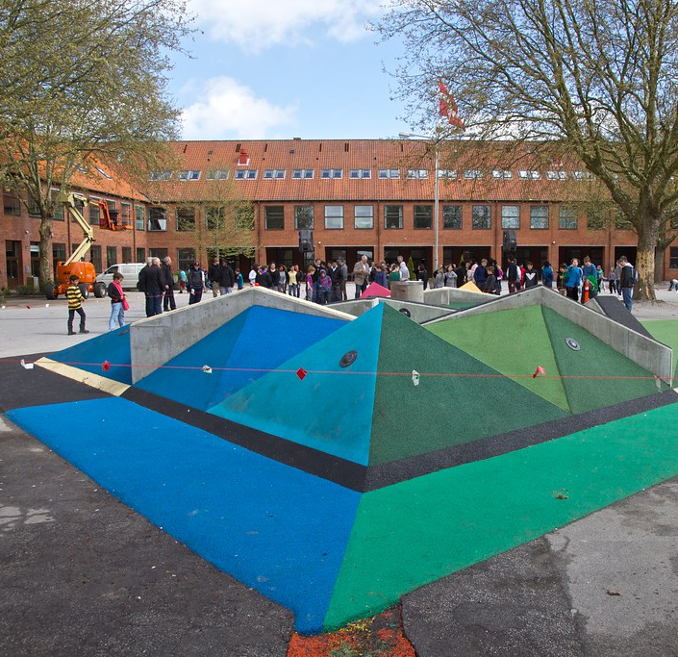
Something about the school:
Risingskolen in Odense is a public school at Risingsvej 25.
It has several buildings and is very large in terms of space.
The school has several gymnasiums, a football field, and a huge yard where students of all ages can meet.
The classrooms are very well and modernly equipped.
And they have separate classrooms for dyslexics and dysgraphics.

Slide 3
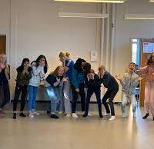
Their classes start at 8:00 a.m., just like here in Slovakia.
Pupils do not change their shoes at school, they hang their coats and other things on hangers in front of the classrooms.
They call teachers by their first names.
The teacher always comes to the classroom 10 minutes before the start of the lesson, waits until everyone has arrived, and then the students hand over their mobile phones and the lesson can begin.

Slide 4
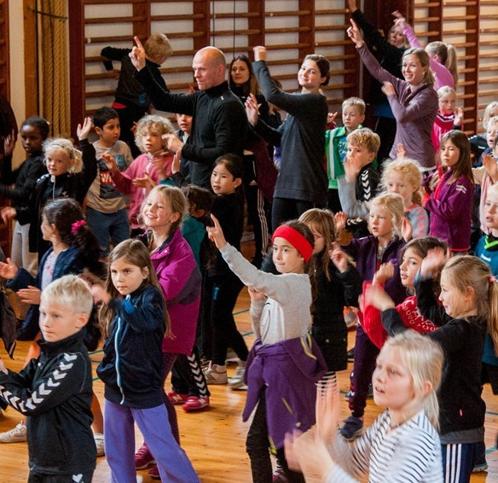
Every Thursday morning they have Assmebly.
They talk about what happened during the week, show each other the projects they worked on, sing, talk...
Thursday is special because all day they have education such as music, technical work, cooking or art.

Slide 5
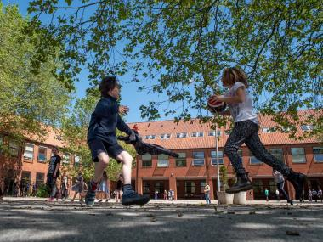
The school has 3 floors.
There are no more than 25 students in one class, and there is one famous person on the door of each class.
Their teaching system is very different, during class they can go to the toilet without being asked or learn from the library.

Slide 6
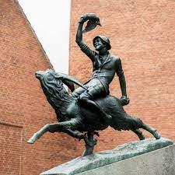
At PE, we were taught folk dances, which were very interesting and fun.
Every day they have a different arrangement of chairs and tables in the classroom.
They work in class with computers instead of textbooks.

